Slide 1



Research on Maternal Health Improvement: reducing rates of low birth weight babies
Angela Jones
Consultant in Public Health

Slide 2
Aims
Why maternal health?
Maternal risk factors in Cwm Taf
BASICS and MAMSS
Low birth weight programme
Best Start – Burdett Trust for Nursing

Slide 3
Low Birth Weight
Low Birth Weight is important because it is closely linked to:
  Increased infant mortality
  Illness and developmental problems in childhood
  Life limiting conditions in adulthood including cardiovascular disease
  Increased risk of having low birth weight children
Contributes to persistent health and social inequalities

Slide 4
Reducing Low Birth Weight
Primary Risk Factors
Lifestyle Factors
Groups highest risk
Low Birth Weight
Smoking & Exposure to second hand tobacco smoke
Bacterial Vaginosis
Short Inter-pregnancy interval
Teenage Pregnancy
Severe Gum Disease
Sexually Transmitted Infections
Low BMI
Consumption of Alcohol in Pregnancy
Substance Misuse
(excl Alcohol)
Smoking or living with a smoker
Risk Taking Behaviours
e.g. unprotected sex
Multiple sexual partners,
Substance misuse
Poor diet
Maternal Nutrition
Air Pollution
Poor housing / environment
Deprived Communities
Young people
Those in manual / repetitive work or who have never worked
Population Attributable Risk Estimates
 | >20%
 | 5-10%
 | 1-5%
 | <1%
 | Not estimated
Source: Johnson, C, 2014

Slide 5
Low birth weight in
RCT Jan – Oct 2013
RISK FACTOR (at booking) | Total <37 weeks gestational age | % | TOTAL 37+ weeks gestational age | % | TOTAL | %
<19 yrs | 8 | 6.4 | 5 | 8.2 | 13 | 7.0
smoking | 39 | 31.0 | 27 | 44.3 | 66 | 35.1
alcohol | --- | --- | --- | --- | --- | ---
Subs misuse | --- | --- | --- | --- | --- | ---
Mental health diagnosis | --- | --- | --- | --- | 10 | 5.4
MH other | --- | --- | --- | --- | --- | ---
BMI 30+ | 40 | 31.7 | 11 | 18.0 | 51 | 27.3
BMI <18.5 | --- | --- | --- | --- | --- | ---
Multiple birth | 33 | 26.2 | --- | --- | --- | ---
Total women | 126 |  | 61 |  | 187
Total babies | 159 |  | 66 |  | 225
*Self reported Jan-May
Source: Cwm Taf Health Board MITS
5

Slide 6
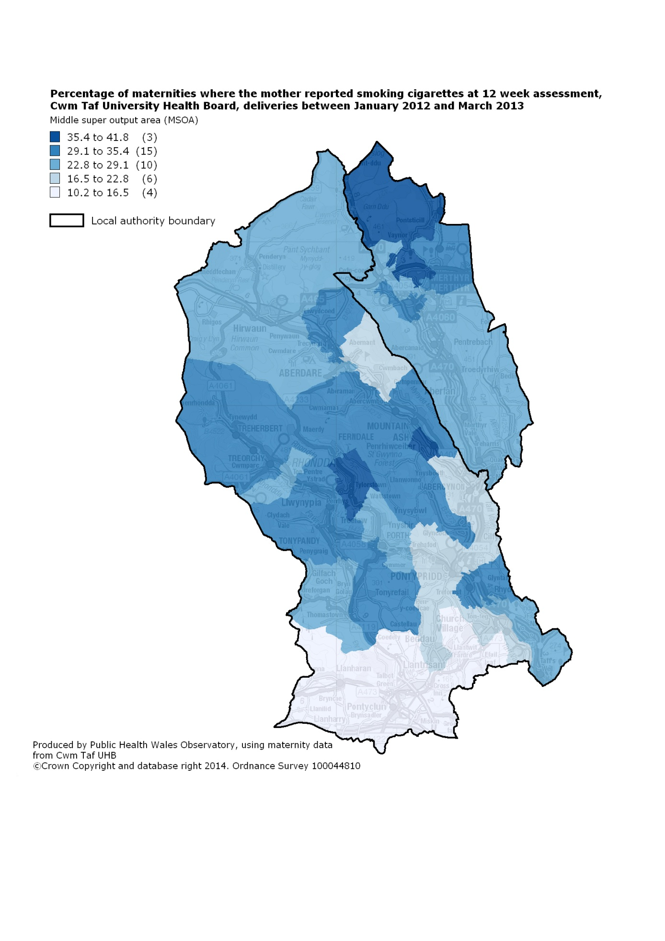
Notes:
The analyses cover deliveries from 1st January 2012 to 31st March 2013 due to data completeness issues of the smoking status field up to 2011.
The extract of data obtained was analysed against the current All Wales Maternity Record form and the former Pontypridd and Rhondda booking form.
Smoking status were taken at the “booking in” assessment which usually (but not always) takes place at around 12 weeks. This should be kept in mind when interpreting the results as some mothers may have stopped smoking part-way through their pregnancy;
Data completeness of the smoking status fields was of overall good quality for the period analysed: January 2012 to March 2013; however, some NULL and zero entries remain and are quantified as 8.0% of maternities for the smoking status field

Slide 7
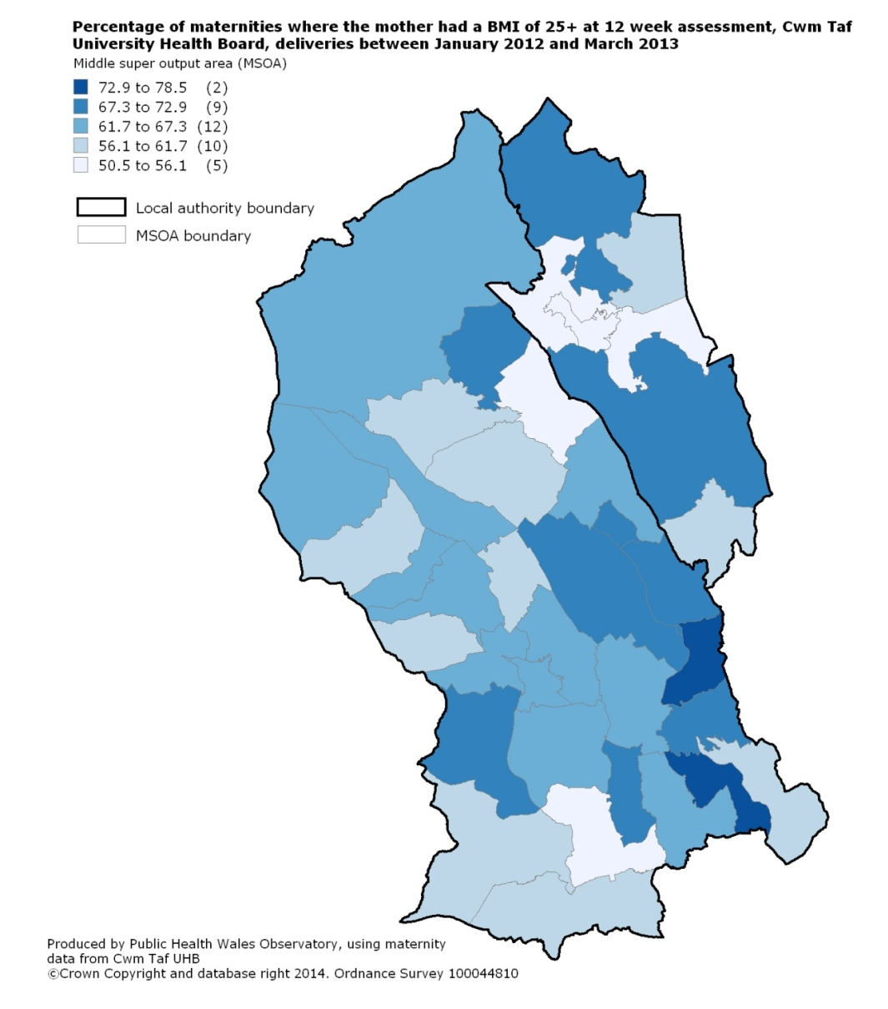
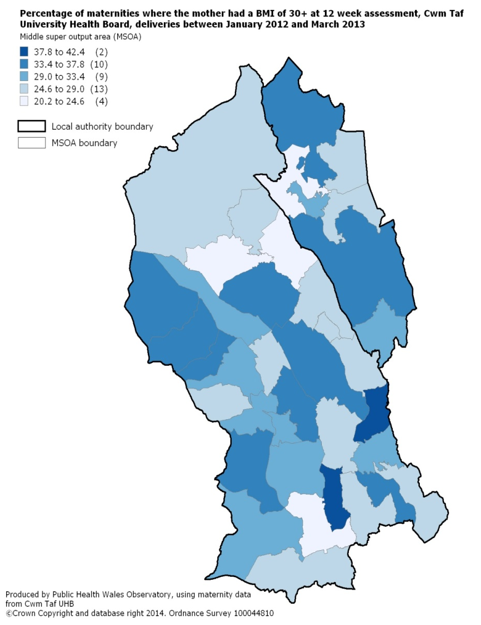
BMI 25+
Maternal overweight
and obesity in Cwm Taf
Jan 2012 – Mar 2013
BMI 30+

Slide 8
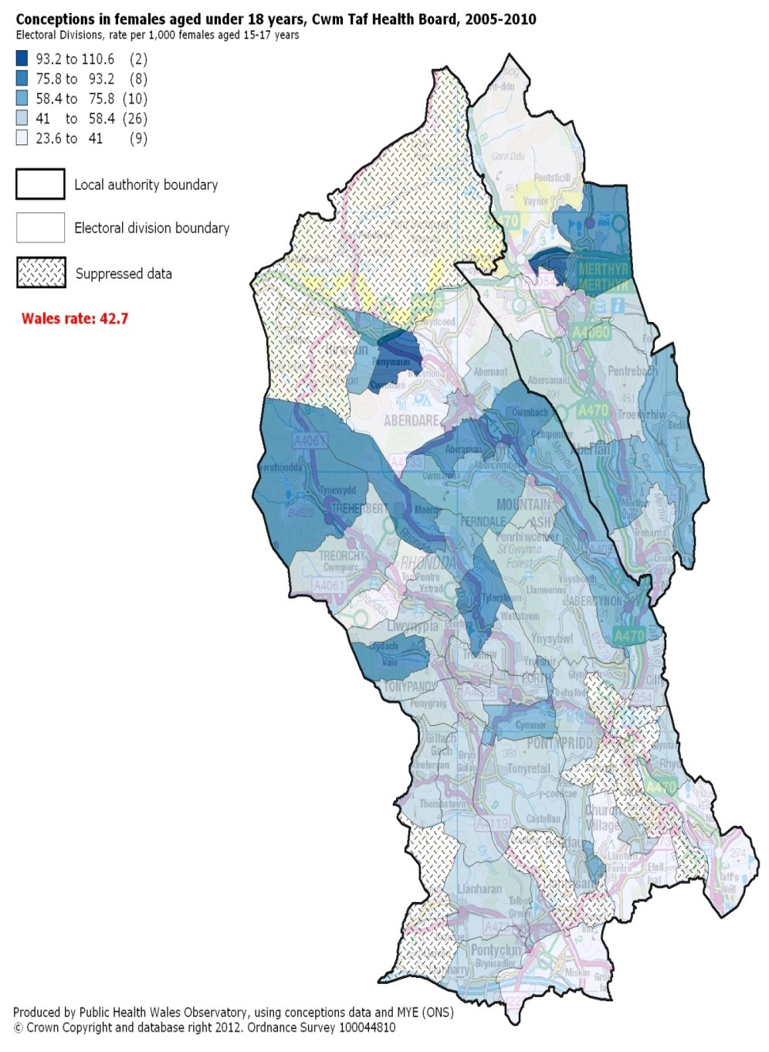
Teenage conception
Needs Assessment and mapping of ‘hotspot’ areas
Multi agency approach
Addressing the gaps
  C-Card, LARC, EHC, Sexual Health Outreach
  Targeting “hot spots
Education
  Risky behaviours
  Mapping SRE and coordinating support
  School Health Nurses
  Healthy Schools Schemes
Notes:
Angela

Slide 9
Barriers to the Acceptance of Smoking Cessation Services in Pregnant Women in South Wales
BASiCS study concluded:
  lack of referral or use of smoking cessation services
  women unaware of the benefit of smoking cessation support
  women responded to these barriers by reducing their smoking rather than stopping altogether
Notes:
BASICS (which aimed to define the barriers which prevent pregnant women from quitting smoking and using smoking cessation services during pregnancy) concluded that:
pregnant mothers who continue to smoke during their pregnancy are not being referred, or decline to use available smoking cessation services. This presents the greatest barrier to smoking cessation as mothers are unaware or are unwilling to avail themselves of the support and services available to them. Although most mothers reported smoking less few were ready to quit. Mothers were aware of the cessation methods available to them but were not motivated to try and stop smoking.

Slide 10
Models for Access to Maternal Smoking Cessation Support (MAMSS)
Combined Project Team – Public Health Wales and Health Board colleagues
Cwm Taf – research approach
Other Health Boards – service evaluation approach:
  Betsi Cadwallader
  Aneurin Bevan
  Abertawe Bro Morgannwg

Slide 11
Outcomes associated with cigarette smoking during pregnancy | Population attributable risk
Ectopic pregnancy | 8%
Placenta praevia | 14%
Placental abruption | 13%
Premature rupture of membranes | 11%
Preterm birth | 13%
Small for gestational age | 25%
Stillbirth | 4-7%
Low birth weight | 10-27%
Sudden infant death syndrome | 26%
Respiratory distress | 10%
Source: Jones et al (2012)
Notes:
Smoking in pregnancy is a major preventable cause of poor outcomes and inequalities in maternal and child health in the short, medium and long term.
The risks of smoking in pregnancy include substantially higher risk of miscarriage, and complications in pregnancy and labour, and increases risk of preterm and low birth weight. Babies are born on average 200-250g lighter, and the more cigarettes smoked the greater the reduction in birth weight.
Due to the levels of harm caused by smoking in pregnancy, measures taken to support women to quit smoking are always cost effective (Richardson, 2009). A Strategic Vision for Maternity Services in Wales, outlines that all women identified in early pregnancy as a smoker, should be offered focused support to quit, rather than to cut down. Studies have shown that structured self-help and support from NHS smoking cessation services, in addition to motivational interviewing techniques are effective in helping pregnant women to quit smoking (Welsh Government, 2011).

Slide 12
Research approach
How can smoking cessation support be optimally delivered to pregnant smokers?
NICE guidance (PH26, June 2010)
Pathway to Portfolio study
  Sponsored and funded by Cwm Taf R&D Department
  9 month research project
3 other Health Boards in Wales looked at other models
  Funded by PHW
  12 month projects
Notes:
The MAMSS study aims to test the hypothesis that the uptake of smoking cessation services by pregnant women will increase if the evidence based NICE guidance and pathways are implemented, and more flexible models of service delivery are offered by a Maternity Support Worker (MSW) sited within the Midwifery team. Thus the numbers of pregnant women who quit will increase.
The NICE guidance (PH26, June 2010) and evaluation of services from other UK countries suggest that a flexible approach is needed for pregnant women, particularly those who are disadvantaged, with the services being offered in a client centred way throughout pregnancy and following childbirth. (Smoking in Pregnancy: Briefing Paper Reproductive and Early Years Pathfinder Project, Public Health Wales, March 2012).

Slide 13
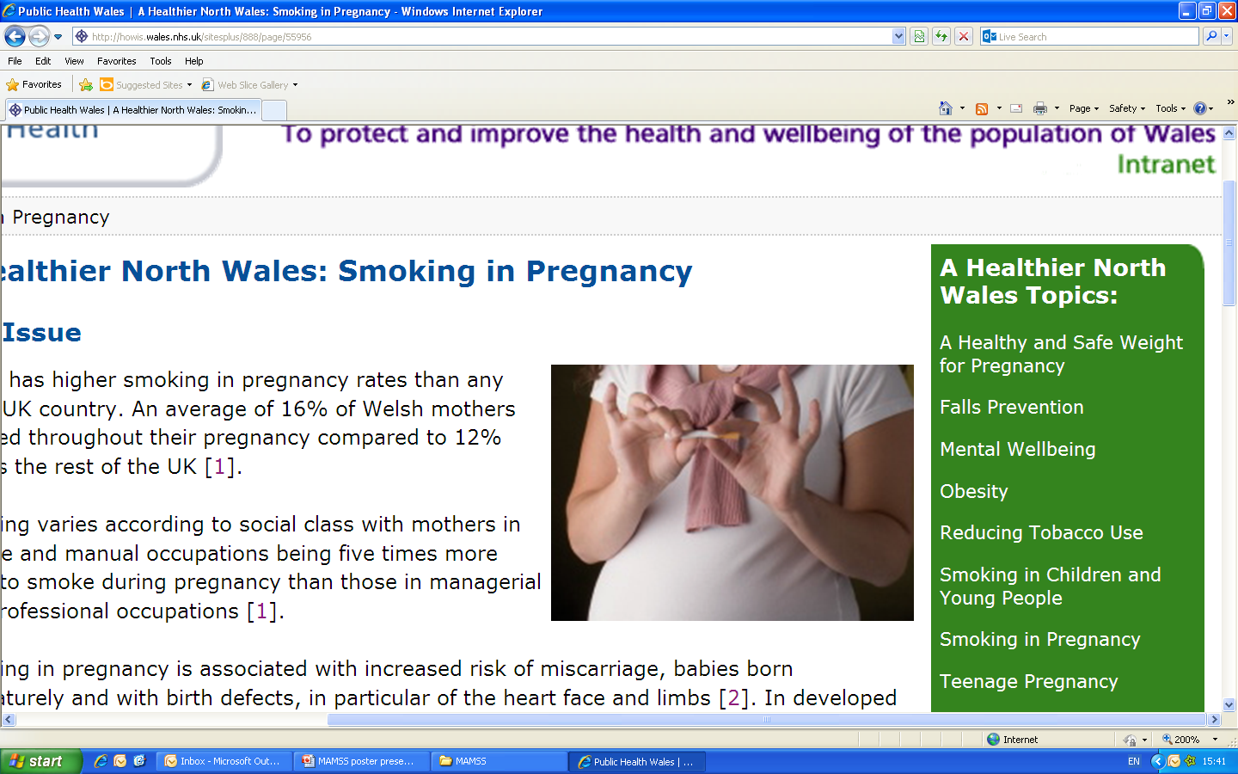
Method

Slide 14
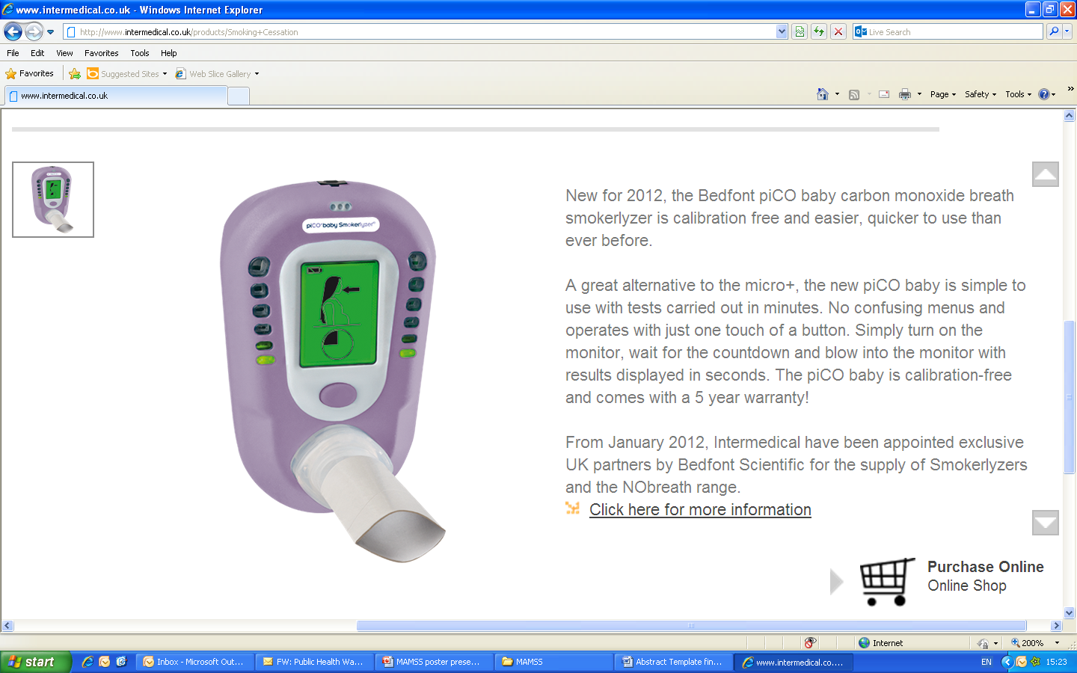
Pregnant women are seen by midwives at first maternity booking and subsequent appointments.
The midwife (following NICE guidelines PH26):
Assesses exposure to tobacco smoke using CO monitor
Discusses the health risks, benefits of stopping smoking and provides information
Refers all pregnant smokers (on opt out basis), with CO reading >7 ppm and those stopped in previous two weeks to NHS Stop Smoking Services.
Usual Care Area (Merthyr Tydfil)
Refer to NHS Smoking Cessation Service (Stop Smoking Wales)
Intervention Area (Rhondda)
Refer to NHS Smoking Cessation Service (Cwm Taf Maternity Support Worker - MSW)
Intense one to one behavioural support for about 6 weeks (plus NRT) from Community Pharmacy
Notes:
The process
Booking?
Quit Manager
MITS
Describe different approach to MSW to SSW
Women seen in own homes etc

Slide 15
Key elements of intervention
MSW 1WTE and 0.1WTE Midwife supervising
Both trained – Maudsley/NCSCT
Provision and training in PiCO monitors
Follow up by MSW
1:1 appointments, convenient to the woman, often at home
Community pharmacy support
Notes:
Notes – also differentiate between SSW & MSW approach

Slide 16
Outcome measures
Primary outcome measure:
Pregnant smokers who engage with specialist smoking cessation services by having at least one face to face therapeutic contact, or treatment session.
Secondary outcome measures:
    Pregnant smokers referred to specialist smoking cessation services by booking Midwife
    Assessment sessions booked and attended
    Pregnant smokers who have quit, defined as 4 week CO validated quitters (Russell Standard).
Notes:
Inclusion criteria
Pregnant:
- aged 16 and over
- Self-reported smoker/CO reading
- Self reported quit in last 2 weeks/CO reading
- Carbon monoxide (CO) reading of 3 parts per million (PPM) or more.
Exclusion Criteria
Pregnant:
- Non smoker (for more than 2 weeks)
- Aged under 16 at booking
- Incapable of giving informed consent, or reduced mental capacity.

Slide 17
Results table

Slide 18
 | Merthyr Tydfil (usual care site) | Rhondda (intervention site) | p value
Total number of pregnant women as % of total | 766 (58%) | 549 (42%)
Number of smokers As % of all pregnant women (95% confidence interval) | 227 30% (27% -33%) | 181 33% (29% - 37%) | 0.20
Number of referrals received* As % of all smokers (95% confidence interval) | 13 6% (3% - 10%) | 159 88% (82% - 92%) | <0.05
Number of referrals accepted** As % of all smokers (95% confidence interval) | 6 3% (1% - 6%) | 107 59% (52% - 66%) | <0.05
Number of treated smokers As % of all smokers (95% confidence interval) | 2 1% (0% - 3%) | 64 35% (29% - 43%) | <0.05
Number quit at 4 weeks As % of all smokers (95% confidence interval) | 2 1% (0% - 3%) | 21 12% (8% - 17%) | <0.05
Number quit at 4 weeks (CO confirmed) As % of all smokers (95% confidence interval) As % of treated smokers (95% confidence interval) | 2 1% (0% - 3%) 100% (34% - 100%) | 18 10% (6% - 15%) 28% (19% - 40%) | <0.05 0.09
Notes:
*Referral from midwife or other health professional has been received by SSW or MAMSS practitioner
**Client has been contacted successfully by SSW or MAMSS practitioner and has made an appointment for support to quit smoking

Slide 19
Percentage of low birth weight babies, by locality, for Cwm Taf UHB Jan 2012- Mar 2015 (source MITS)
MAMSS starts
1st MAMSS babies

Slide 20
Conclusions
Embedding smoking cessation support in maternity services with a Maternity Support Worker, significantly increased referral, engagement, and uptake by pregnant smokers
All women regardless of smoking status offered CO monitoring
Use of PiCO carbon monoxide monitors
Ripple effect for families
Notes:
Pregnancy has been recognised as a ‘window of opportunity’ for smoking cessation (McBride, 2003; Fendall et al, 2012). The MAMSS project harnessed this opportunity to provide a novel way of delivering stop smoking services to pregnant women in Wales through embedding stop smoking services within maternity care. The outcomes demonstrate that women living in areas where the stop smoking in pregnancy service was delivered by a dedicated, bespoke smoking in pregnancy practitioner were more likely to be referred to and engage with specialist stop smoking services compared with the usual care service.
The findings from this study have shown that pregnant smokers who received the MAMSS intervention were significantly more likely to be referred and engage with specialist stop smoking services (measured by the proportion of pregnant smokers defined as treated smokers) compared with the usual care service. The low percentage of referrals received in the usual care arm of the study possibly reflects the benefits of having the provision of the smoking cessation service embedded within the maternity service, which allows for regular feedback to midwives and maintaining the profile of the service in the intervention areas. Based on our primary outcome measure, Cwm Taf UHB (MSW model) had the highest proportion pregnant smokers who went on to become a treated smoker (35%)
Visual
Increase in pregnant smokers identified with CO monitoring
recorded in All Wales Maternity Record, input into MITS
– passive smoking education, other family members quitting
Other benefits e.g. faulty boilers identified by CO test at booking.

Slide 21
Low Birth Weight Programme
Combined approach to address the two biggest risk factors in Cwm Taf:
Smoking
Obesity
Funded by Families First in Rhondda Cynon Taf
Intervention:
Roll out MAMSS to Cynon and Taf localities
Introduce Bump Start (Doncaster Model) for women with a BMI 35+

Slide 22
Cwm Taf UHB -Antenatal Visiting Schedule - BMI ≥ 30
Booking Appointment BMI 30-34.9 no other risk factors book for MLC and Birth Centre/homebirth if wishes
BMI 35 – 39.9 | BMI ≥ 40
Consultant led care Refer to Healthy Lifestyle Midwife | Consultant led care Refer to Healthy Lifestyle Midwife
16 weeks - Healthy Lifestyle Midwife and Dietitian. Risk assessment. Appt given for Glucose Tolerance Test at 28 weeks | 16 weeks - Healthy Lifestyle Midwife and Dietitian. Risk assessment. Appt given for Glucose Tolerance Test at 28 weeks
Anomaly USS | Anomaly USS
24 weeks - Healthy Lifestyle Midwife and Dietitian Weight | 24 weeks - Healthy Lifestyle Midwife and Dietitian Weight/referral to Anaesthetist
28 weeks - Community Midwife GTT | 28 weeks - Community Midwife GTT
31 weeks - Community Midwife | 29 weeks – Consultant Review Serial growth/USS
34 weeks - Community Midwife | From 30 weeks – Anaesthetic Review
36 weeks – Healthy Lifestyle Midwife Weight | 36 weeks – Healthy Lifestyle Midwife Weight Complete moving and handling assessment Discuss/complete birth plan
38 weeks - Community Midwife | 38 weeks - Consultant Review Growth USS and presentation Plan for delivery/IOL
40 weeks - Community Midwife | 40 weeks - Community Midwife
41 weeks - Community Midwife | 41 weeks - Community Midwife

Slide 23
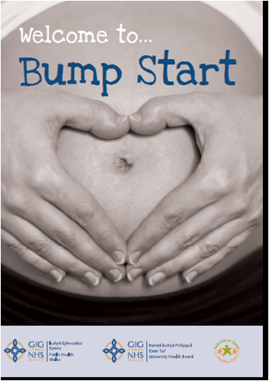
Results
Programme currently running
Quantitative analysis to be undertaken with SAIL database – Catherine Floyd
Qualitative analysis of
Bump Start–
Kathryn Ashton
Public Health Wales

Slide 24
Bump Start Qualitative Study
Feasibility
    Received well by both staff and clients– empowered to take control of the service being provided.
    Importance of involving clinicians in development of services.
    Importance of communication between professionals.
Acceptability
  Only 6.2% (n=9) of eligible clients refused the service.
  Majority of clients reacted positively to the service
  Particularly welcomed for second pregnancy.
  83.8% (n=114) of eligible clients attended the first two Bump Start sessions.
  Service users appreciated the dedicated time offered to them.
Weight gain
  29.6% (n=24) of Bump Start clients gained 5-9kgs during pregnancy. This compared to 13.3% (n=4) of the women receiving standard care.
  However, the difference was not statistically significant (p=0.079) due to small sample size.
Notes:
Weight gain
29.6% (n=24) of Bump Start clients gained 5-9kgs during pregnancy. This compared to 13.3% (n=4) of the women receiving standard care.
However, the difference was not statistically significant (p=0.079) due to small sample size.

Slide 25
Further developments
  Flying Start funding from Merthyr Tydfil County Borough Council for MAMSS agreed 2016/17
  Burdett Trust for Nursing £200k funding to develop a programme of lifestyle support , Best Start, for women with a BMI ≥30 until March 2018. R&D support for ethical approval underway
    Delivered in community venues
    Delivered by Maternity Support Workers
    Foodwise in Pregnancy programme

Slide 26
Acknowledgements
Women and their families
Midwives and associated team members
Margaret Munkley, Julie Evans, Sharon John, Angela Bell, Alison Lindley, Alison Reardon, Gail Murphy
Cwm Taf Research and Development Department – John Geen; Rhian Beynon; Amy Jordan
Rachel Fielding, Head of Midwifery, Gynaecology & Sexual Health
Nicola John, Director of Public Health
Howard Rowe, Clinical Director, Head of Medicines Management
Emma Williams and Community pharmacies in Cwm Taf
Stop Smoking Wales
MAMSS steering group
Public Health Wales Observatory
Kathryn Ashton, Public Health Wales
Catherine Floyd Public Health Wales

Slide 27
References
McAndrew, F., Thompson, J., Fellows, L., Large, A., Speed, M. and Renfrew, M.J (2010) Infant Feeding Survey. The Health and Social Care Information Centre.
Dolman, R., Gibbon, R., and Roberts, C. (2007) Smoking in Wales: Current Facts. Wales Centre for Health.
Johnson, C (2014) Low birth weight: a review of risk factors and interventions, Public Health Wales
Jones et al (2012) Smoking in Pregnancy: Briefing Paper Reproductive and Early Years Pathfinder Project. Public Health Wales.
Lumley, J., Chamberlain, C., Dowswell, T., Oliver, S., Oakley, L. and Watson L. Interventions for promoting smoking cessation during pregnancy. Cochrane Database of Systematic Reviews (2009), Issue 3. Art. No.: CD001055. DOI 10.1002/14651858.CD001055.pub3
Quitting smoking in pregnancy and following childbirth. NICE public health guidance (PH26, June 2010)
Richardson, A. (2009) Investing in Public Health: A briefing paper for the Canterbury District Health Board. Available at http://www.cph.co.nz/Files/InvestingInPublicHealth.pdf (accessed 13.10.14)
Public Health Wales Observatory (2014) Small area analysis of the Cwm Taf University Health Board maternity database. http://howis.wales.nhs.uk/sitesplus/922/page/59471 (accessed 13.10.2014)
Welsh Government (2011) A Strategic Vision for Maternity Services in Wales. Welsh Government.
West, R.(2005) Assessing smoking cessation performance in NHS Stop Smoking Services: The Russell Standard.

Slide 28
Any questions?

