Slide 1
Corporate slide master
With guidelines for corporate presentations
Health Research in Wales Aligning Policy and Research Priorities
Dr. Frank Atherton
Chief Medical Officer, Welsh Government
Notes:
1

Slide 2
Wales
Population ~ 3 million
Health Status
Planned Healthcare system
Public Health Wales
Health/Wellbeing Future Generations
Prudent Healthcare
Long (and recent) history of social justice
Outward facing

Slide 3


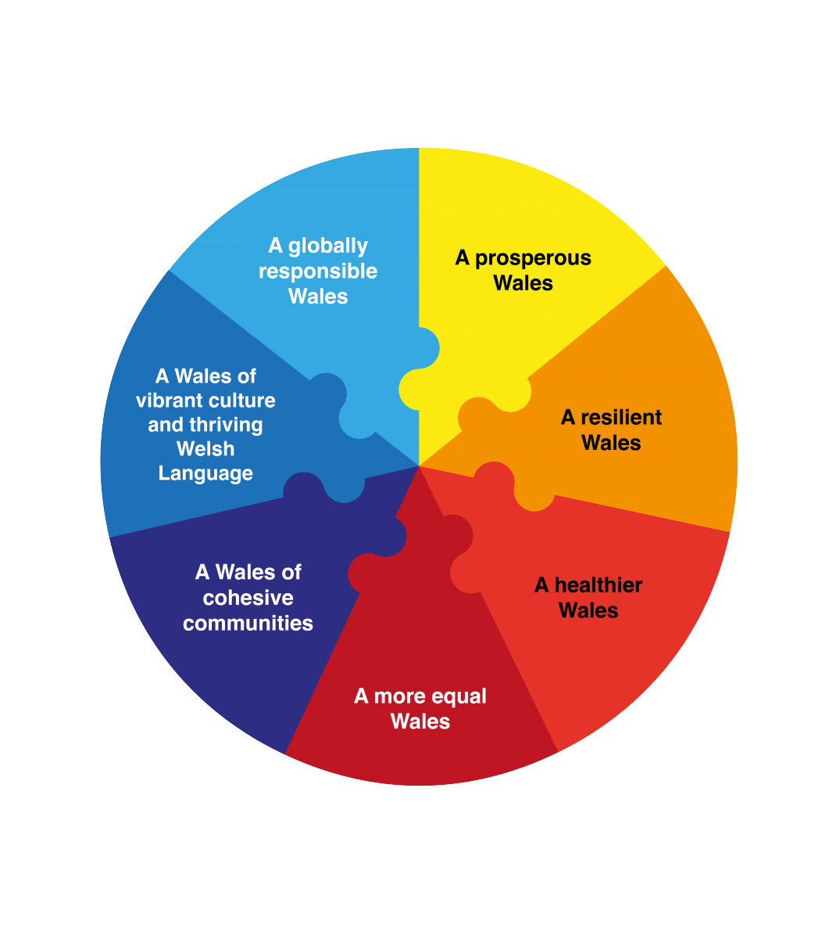
Welsh Government Priorities
Taking Wales Forward
The Well-being Goals and Ways of Working require public bodies, including the Welsh Government, to think more about the long-term, to work better with people, communities and each other, look to prevent problems and take a more joined-up approach – helping us to create a Wales that we all want to live in, now and in the future.
Well-being of Future Generations Act
“A society in which people's physical and mental well-being is maximised and in which choices and behaviours that benefit future health are understood”
"Responsible government is not just about delivery in the here and now, vital though it is. It’s also about looking towards the end of the decade and beyond, with a vision of the Wales we want for the future“
Rt Hon Carwyn Jones AM, First Minister of Wales

Slide 4
Population Health Priorities: Unfinished Business
Improving Health Outcomes
Proximal determinants; smoking, alcohol, drugs
Health Settings
  Schools, workplace, colleges, universities, prisons
Evidence Based Programs
  Healthy Child Wales, First 1000 Days, Adverse Child Experiences

Slide 5
Population Health Priorities:
Unsolved Problems
Inequalities
Obesity/Healthy Lives
Mental Health
Healthy Environments
  HWB Future Generations
  Health in All Policies and Health Impact Assessment
Large scale societal change

Slide 6
Population Health Priorities: New/Emerging Challenges
Common Pathways to Addiction
  Gambling
  Nicotine
Corporate Determinants of Health
Communicable Diseases have not gone away
  PanFlu, H7N9, MERS, Ebola, Zika, WNV, Lyme

Slide 7
The Value of Research
Scoping the problems
Testing interventions
Building an evidence base
Building capacity and capability
Creating high-quality jobs and generating wealth

Slide 8
Some Challenges in Research
Getting the balance right:
  Capacity building vrs policy/practice/public need
  Researcher-led vrs commissioned research
Identifying the right research questions – alignment with need
Effective collaboration - alignment of research strategies (eg Health and Care Research Wales/PHW)

Slide 9
Health and Care Research Wales
A national (all Wales), virtual organisation, created, funded and overseen by the Welsh Government.
Funds a mix of infrastructure, funding schemes and service-based research support and delivery.
Budget: £43m

Slide 10
Health and Care Research Wales
Funding Schemes
Features to support alignment of research with need:
  Welsh Government Theme Briefs
  All Wales Prioritisation Panel
Recently funded projects: e.g. prudent healthcare, mental health in secondary schools, Human Transplantation Act, Physical activity, eating disorders

Slide 11
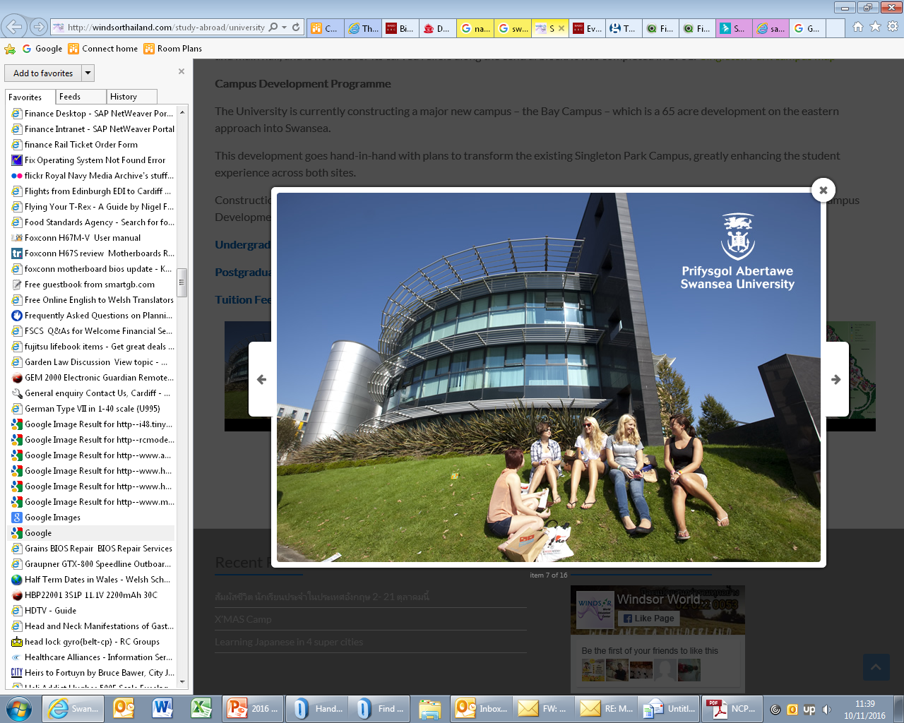


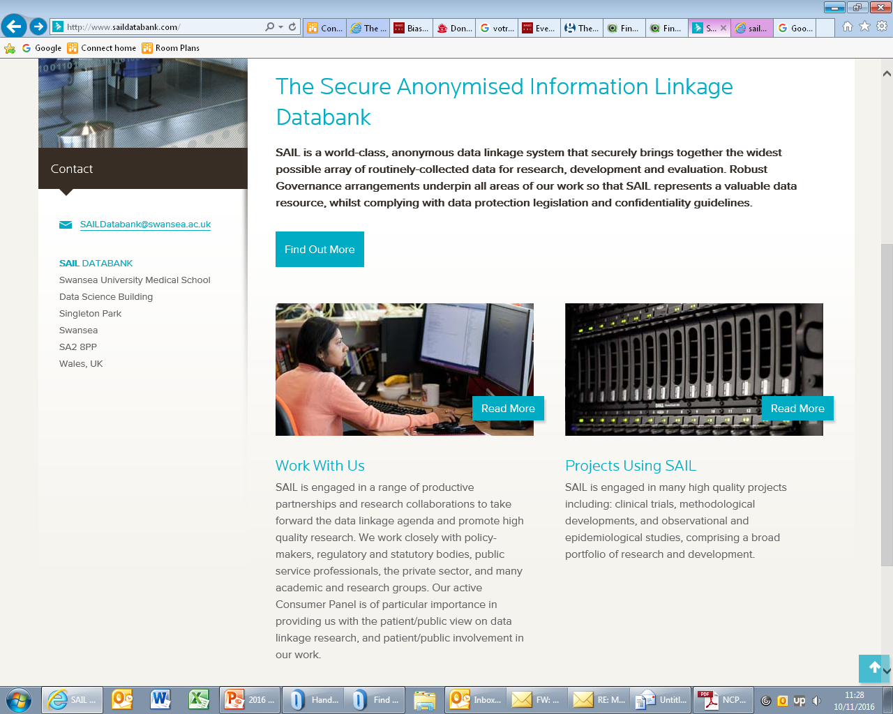
National Centre for Population Health and Wellbeing Research (NCPHWR)
Multi-institutional, multi-disciplinary, multi-agency health and social care research
Public, policy-maker and practitioner collaboration across Wales
Building on existing areas of scientific excellence in Wales
  Children and young people
  Promotion and maintenance of health through an extended working life
  World-leading research infrastructure support

Slide 12
Secure Anonymised Information Linkage Database (SAIL)
Funded since 2006 by R&D Division as part of Welsh research infrastructure (Internationally-recognised expertise in data linkage and use)
SAIL holds anonymised, person-based datasets which, subject to safeguards, can be linked to address important research questions
More than £50m generated in grant capture since 2006
This includes:
  Farr Institute (1 of 4 UK centres of excellence for health informatics research)
  Administrative Data Research Centre ( 1 of 4 UK awards via ESRC)

Slide 13
Centre for the Development and Evaluation of Complex Interventions for Public Health Improvement (DECIPHer)
A UKCRC Public Health Research Centre of Excellence (one of five)
Focus on risk behaviours in children and young people
Examples of work with policy significance
  Free school breakfasts
  Exercise referral
  E-cigarettes

Slide 14
Other UK Initiatives
NIHR Public Health Research Programme
National Prevention Research Initiative (NPRI) (e.g. Strengthening Families evaluation)
Emerging UK Prevention Research Partnership

Slide 15




HealthWise Wales
29 February 2016 launch
Sign-up via website or telephone
National campaign to promote participation
Aims to recruit 260,000 people over 5 years
Almost 6,000 participants joined to date
www.healthwisewales.gov.wales
0800 9 172 172

Slide 16
Summary
A lot going on, many key initiatives in place
Need for
  greater visibility
  better co-ordination and collaboration
  stronger alignment of strategies
  stronger alignment of research and policy priorities
THANK YOU

