Slide 1
The collaboration between South Wales Police, NSPCC and PHW to understand the Police response to vulnerability
Chief Inspector John Wainwright, Shaun Kelly and
Dr Kat Ford

Slide 2
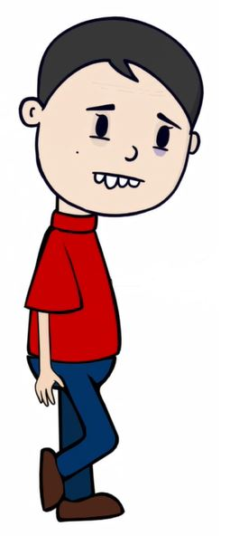
Adverse Childhood Experiences (ACEs)
‘Adverse Childhood Experiences
(ACEs) are stressful experiences that occur during childhood (before the age of 18) that directly harm a child (e.g. sexual or physical abuse) or affect the environment in which they live (e.g. growing up in a house with domestic violence)
Bellis et al 2016

Slide 3
Welsh ACE study - PHW Reports
Notes:
The national survey of Adverse Childhood Experiences in Wales interviewed approximately 2000 people (aged 18-69 years) from across Wales at their homes in 2015. Of those eligible to participate, just under half agreed to take part and we are grateful to all those who freely gave their time. (49% compliance)

Slide 4
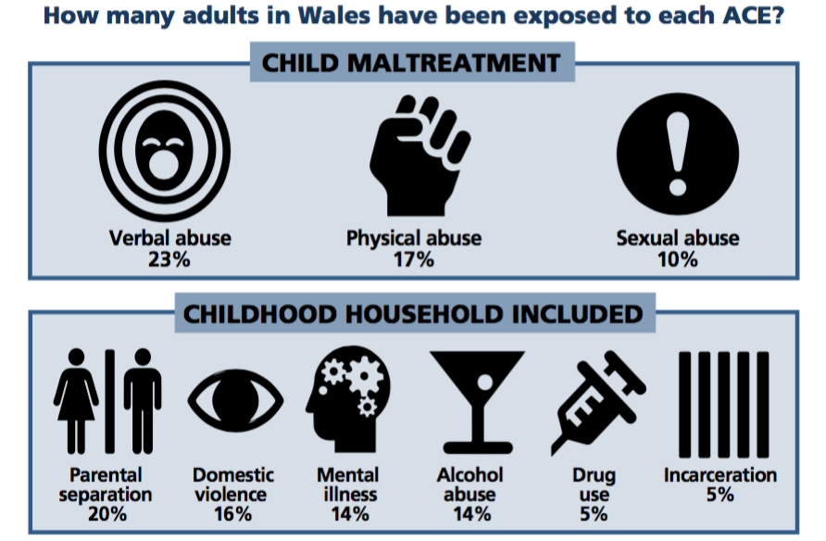
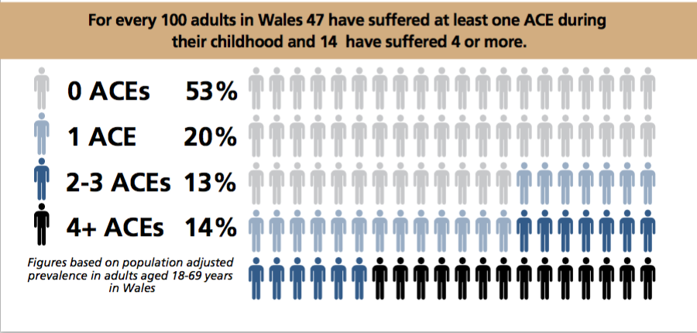
Welsh ACE study
Welsh ACE study - Exposure
Notes:
This slide shows the 9 ACEs measured in the Welsh Survey and the percentage of adults who experienced each ACE under the age of 18 years, key points for this slide
ACEs are stressful experiences occurring during childhood that directly hurt a child (e.g. maltreatment) or affect them through the environment in which they live (e.g. growing up in a house with domestic violence).
This first Welsh ACE survey identifies that substantial proportions of the Welsh population have suffered abuse, neglect and other ACEs during their childhood.
There are 9 ACEs which have been included in the study. These have come from …… and are significant because …….. Whether you are poor or not, experiencing these ACEs can have the same impact. Although you are more likely to experience ACEs if you live in a deprived area and you are less likely to have protective factors.
Such stress arises from the abuse and neglect of children but also from growing up in households where children are routinely exposed to issues such as domestic violence or individuals with alcohol and other substance use problems. Collectively such childhood stressors are called ACEs (Adverse Childhood Experiences). ss.
Preventing ACEs can improve health across the whole life course, enhancing individuals’ well-being and productivity while reducing pressures and costs on the National Health Service (NHS). Those experiencing more ACEs are also more likely to be involved in violence and other anti-social behaviour and perform more poorly in schools. Thus, health, social, criminal justice and educational systems are all likely to see better results for the Welsh population if ACEs are prevented.
Suggested interaction:
Ask your audience what do they think the prevalence is for each one, is this more or less than expected?
This is the prevalence of ACEs in Wales.

Slide 5
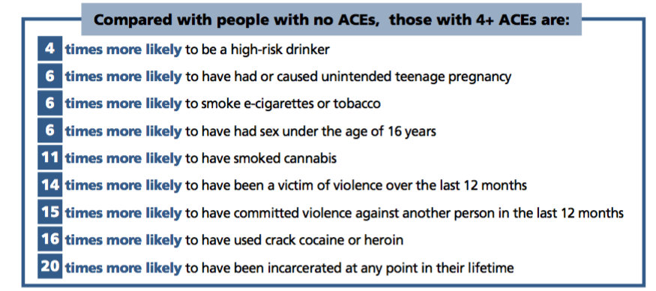
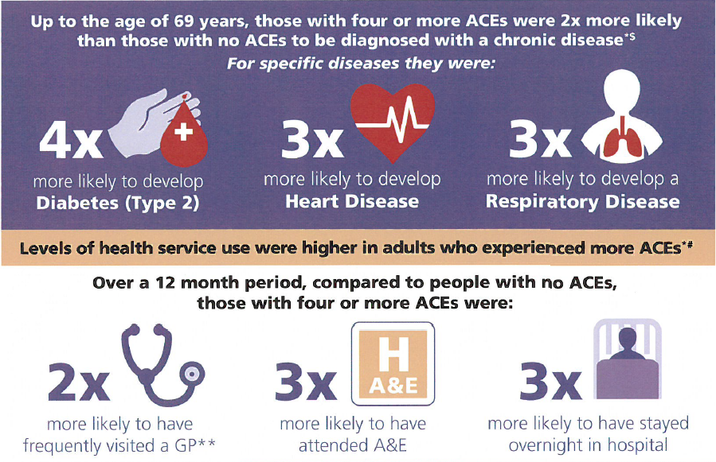
ACEs – The Increased Issue
Notes:
This slide shows how much being exposed to 4 or more ACEs can increase the risk for health harming and criminal behaviours, key points to cover:
Compared with someone who has no ACEs, having 4 or more ACEs can <pick out the most relevant for the audience>
The impact of ACEs is every bodies business, tackling ACEs is our common purpose

Slide 6
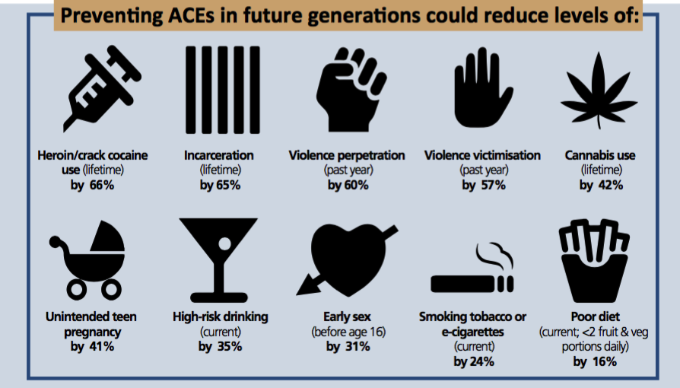
ACEs – Prevention
Notes:
This slide shows how much being exposed to 4 or more ACEs can increase the risk for health harming and criminal behaviours, key points to cover:
Compared with someone who has no ACEs, having 4 or more ACEs can <pick out the most relevant for the audience>
The impact of ACEs is every bodies business, tackling ACEs is our common purpose

Slide 7
Police and ACE’s
In one area of South Wales between 4th June 2015 and 18th November 2015 (24 weeks) 1,484 Public Protection Notifications were received by social services from the police
11% (167) Public Protection Notifications progressed
Sexual abuse
89% (1,317) Public Protection Notifications logged and closed
Physical Abuse
Domestic Violence
Mental Health
Drug Use
Separation
Alcohol Abuse
Incarceration
Verbal Abuse
Notes:
Use this slide to demonstrate how partner agencies such as the police often identify individuals and families who have ACEs but current systems are not always able to respond early enough. Key points to cover:
• Approximately 90% of demand on police is not crime related but relates to complex welfare, public safety and vulnerability issues, making the Police well placed to intervene more effectively and reduce impact of ACEs.
Not just vulnerability but antisocial behaviour can be an indicator of ACEs
• ACE prevention is direct crime prevention breaking the generational cycle (remember 20 times more likely to end up incarcerated)
• Significant amount of police resource (is used to operate a system which identifies and records vulnerability and notifies social services (Public Protection Notifications – PPNs. All Police forces will have a similar but may call them something different).
• In one area, only 11% of PPNs submitted to Social Service meet the threshold for action
• We must build capacity to deal with some issues at point of contact, making every contact count.
• Police can be ill-equipped to respond effectively to many of these recurrent issues, such as low level mental health, family conflict, missing persons and vulnerability, meaning we perpetuate the generational cycle of abuse and crime by taking ineffective or no action to intervene earlier, shifting the responsibility to another agency.
• Cases continue to escalate, causing greater harm, increasing police incidents.
• High threshold intense services are often too little, too late and very expensive.
<case study to go in here>

Slide 8
Early Intervention and Prompt Positive Action
Early Intervention and Prompt Positive Action:
Breaking the Generational Cycle of Crime
2 year; April 16 - March 18
The two year programme is the only one of its kind in the UK, it is funded by the Home Office’s Police Innovation Fund and is being piloted in the Bridgend area.
Public Health Wales, The Police and Crime Commissioner, South Wales Police, NSPCC Cymru, Barnardos and Bridgend County Borough Council
Develop a long-term approach to reduce ACEs and support those affected.

Slide 9
Research with and for the Police
SPR
YOS
PSC
Shared understandings
Limitations
Policies and protocol
Ethical research
Development of protocol for research observations
ACRONYMS
PPU
OCGs
Niche
TRM
YJB
TAU
MG11
NC5
MBT
ICCI
LPIs
LAAA
IAPT
FACTS
EDT
FDAC
ECM
DMM
D&D
DP
DCF
PPN
PIF
NFA
NOMS
CSE
BCU
CAMHS
PNB

Slide 10
Research with the Police
Conducting research with an operational organisation
Recruitment issues
Working different hours
Shared calendar
Information sharing
Governance

Slide 11
11
3rd March 2017
The Adverse Childhood Experience Project & South Wales Police
27/02/2017
Notes:
11

Slide 12
Key Issues
Protecting the vulnerable is now SWP’s top priority
The role of the Police and Crime Commissioner in the ACE project
The key challenges for SWP are:
Altering current operational procedures without clarity from the outset about what that looks like
Notes:
Protecting the Vulnerable: the wider context across the Police Service and SWP – ACE Project is therefore aligned to our key priority
Demand: approx. 80% of our demand is now around vulnerability – the changing profile of policing.
Our Plan includes as key priority areas – PROTECTING VULNERABLE PEOPLE and EARLY INTERVENTION & PROMPT POSTIVE ACTION
2. The ACE project catalyst was the PCC who successfully bid for PIF money –
the role of the PCC and commissioning work between partners
Our response to working closely with Health partners…Mental Health CONCORDAT – a range of measures to reduce those in MH crisis coming into the CJ system / Help Points in Swansea and Cardiff / Ambulance response times / Custody and CJ issues
3. The standard challenges of collaboration: GOVERNANCE, including with the Police and Crime Commissioner, DATA SHARING, COMMUNICATIONS etc
But the 2 main challenges are –
Making alterations to existing procedures but without being able to explain what that is going to look like from the outset:
CULTURE, RISK,

Slide 13
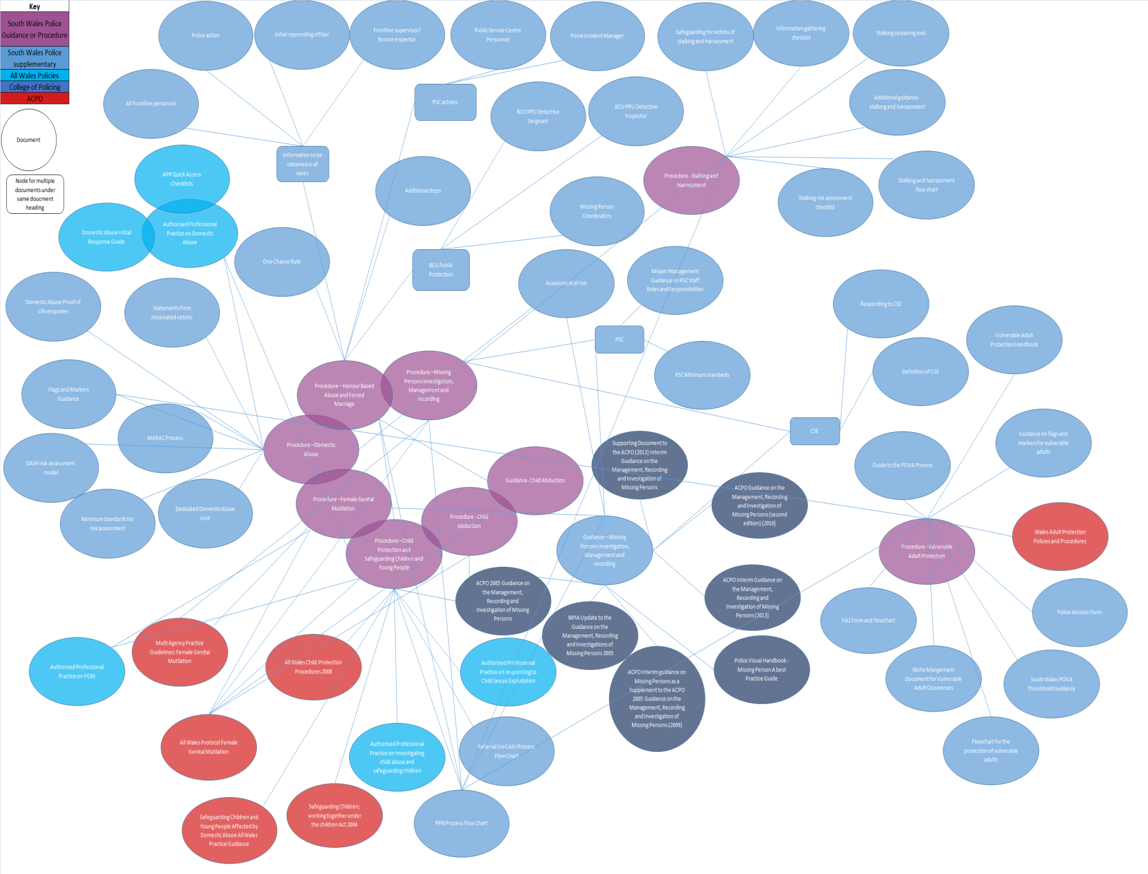
Police Policies Overview

Slide 14
Key Issues
Protecting the vulnerable is now SWP’s top priority
The role of the Police and Crime Commissioner in the ACE project
The key challenges for SWP are:
Altering current operational procedures without clarity from the outset about what that looks like
The changing role of police officers
Notes:
PROTECTING THE VULNERABLE: this is the wider context across the Police Service and SWP – ACE Project is therefore aligned to our key priority
Demand: approx. 80% of our demand is now around vulnerability – the changing profile of policing.
Our Plan includes as key priority areas – PROTECTING VULNERABLE PEOPLE and EARLY INTERVENTION & PROMPT POSTIVE ACTION
2. ACE PROJECT CATALYST: the PCC who successfully bid for PIF money –
the role of the PCC and commissioning work between partners
Our response to working closely with Health partners…Mental Health CONCORDAT – a range of measures to reduce those in MH crisis coming into the CJ system / Help Points in Swansea and Cardiff / Ambulance response times / Custody and CJ issues
3. CHALLNEGES OF COLLABORATION: GOVERNANCE, including with the Police and Crime Commissioner, DATA SHARING, COMMUNICATIONS etc
But the 2 main challenges are –
Making alterations to existing procedures but without being able to explain what that is going to look like from the outset:
CULTURE, RISK,
What might this mean for the role of police? less about crime fighting, more about dealing with VULNERABILITY – being expected to do some of the role of other public servants around HEALTH, EDUCATION, SOCIAL SERVICES, AMBULANCE etc
4. WHAT WILL SUCCESS LOOK LIKE:
5. WHAT WILL CHANGE AS A RESULT:

Slide 15
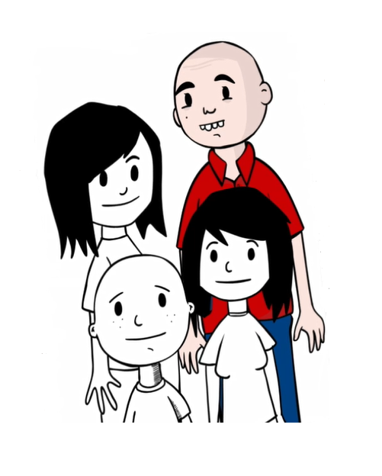
Next steps for Early Intervention and Prevention Programme
Next Steps......
Carry out training with South Wales Police from recommendations in Investigative report.
Trial and Test recommendations in investigative repport.
Work with Bridgend County Council to develop:
An ACE Informed whole school pilot.
ACE Informed Housing
And most importantly – MAKE A DIFFERENCE

Slide 16
‘Two Nations divided by a common language’ (but share a common Ambition)
Fast and Slow thinking (and action) – when is a recommendation a ‘to do’ or a ‘to consider?
‘You say Potato and I say Potato’ – Same words different meanings
Treading the line between pragmatism and compromise – Can do sometimes doesn’t do
‘You need to speak to…’ – Organisational Sat Navs don’t work
‘You occupy this much of my world’ – Understanding where you (and the project) are in the scheme of things
Whilst ‘faith may move mountains’ only leaders can decide when, how far and which one.

Slide 17
‘When you need to innovate, you need collaboration.’ Marissa Mayer
When it’s important to Leaders it’s important to the Workforce
The ‘Outcome’ is a good place to start
‘Why?’ from an outsider becomes the best question
21st Century Public Servant - Build up ‘Tacit’ knowledge and understanding
A ‘wicked’ problem can lead to a ‘wicked’ innovation

Slide 18
Thank you
Chief Inspector John Wainwright
john.wainwright@south-wales.pnn.police.uk
Shaun Kelly
Shaun.Kelly@NSPCC.org.uk
Dr Kat Ford
Katharine.ford@wales.nhs.uk

