Slide 1
The purpose of research is to change the world, not just to understand it
Marcus Longley
Professor of Applied Health Policy
Director of the Welsh Institute for Health and Social Care, University of South Wales
Vice Chair, Cardiff and Vale University Health Board

Slide 2
Three Questions
Why research?
What determines impact?
Future direction?
With a few examples…

Slide 3
By ‘research’ in this context I mean…
The generation and dissemination of new knowledge…
… relevant to current issues…
… capable of being used
Of good enough quality:
reliable, valid, trustworthy…
Using whatever methods are appropriate:
quantitative, qualitative, mixed; exploratory, deliberative, evaluative, synthetic…

Slide 4
Three Questions
Why research?
What determines impact?
Future direction?

Slide 5
Why research?
Because we don’t yet know how to:
Concentrate on outcomes
Remodel care
Make change happen
In broad terms, we often know WHAT to do, the challenge is HOW to do it

Slide 6
For example…
If we want to have a significant and sustained impact on our health, we should tackle ACEs. This is a big challenge. Therefore we need to:
Concentrate on outcomes
Research can highlight relative risks and benefits
Remodel care
Research can test the alternatives
Make change happen
Research can sharpen our tools and motivate us

Slide 7
NB for the purposes of this talk, research is… The generation and dissemination of new knowledge, relevant to current issues, and capable of being used

Slide 8
Three Questions
Why research?
What determines impact?
Future direction?

Slide 9
Who is research for?
Politicians*
Policy makers*
Managers*
Practitioners*
Clients/patients
Public *in all relevant sectors
Concentrate on outcomes
Remodel care
Make change happen
Therefore…
research needs to recognise the needs of each stakeholder, and address them

Slide 10
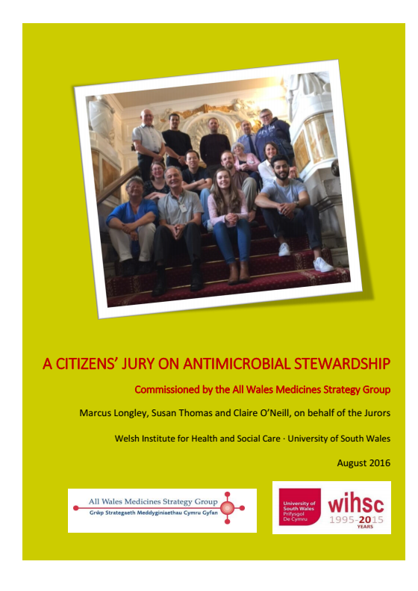
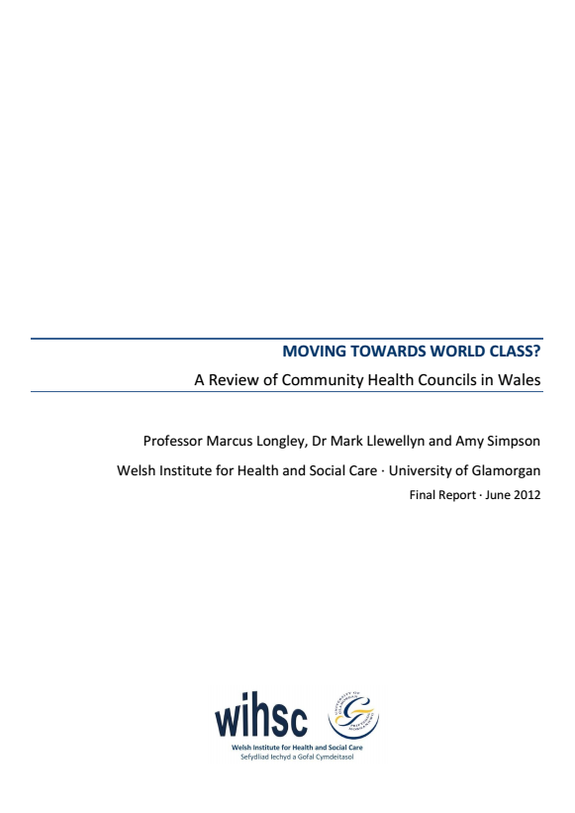
Some handy hints, if you want to make an impact…
Answer the right question
Think about the issue from stakeholders’ perspectives
Focus on the purpose of the research
Focus on ‘good enough’
Understand the ‘burden of proof’
Be timely
Take people with you
Communicate effectively
Horses for courses
Answer the questions

Slide 11
Please don’t…
Rehearse the problems and say nothing about the solutions
Give broad-brush solutions with no regard to practicality
Give too many recommendations
In other words, avoid analysis/paralysis, platitude and teaching grandma to suck eggs!

Slide 12
Three Questions
Why research?
What determines impact?
Future direction?

Slide 13
Simple…
All the stakeholders need to contribute to:
Setting the priorities
Agreeing the questions
Contributing the data
Using the results
The research community needs to own this
We’ve already got quite an infrastructure – use it
Significant research expenditure
Significant help (NICE, AWMSG, PHW, Royal Colleges, Think Tanks, Third Sector, WAO, Inspectorates…)

Slide 14
Not quite so simple
Asking the right question is hard
Honesty and mutual understanding; multiple stakeholders
Being quick, relevant and robust isn’t easy
Reliable evidence is really hard to gather
You seldom get a simple answer
Limited evidence, context, caveats and nuance
Academic needs can conflict with the real world
Conflicting priorities
The urgent usually trumps the important
We have varied and complex perspectives on The Truth

Slide 15
But there are things we can do…
Expect policy to be tested by research
Get researchers closer to the stakeholders
Design in evaluation from the start
Prove the utility of research to the stakeholders
Build a more evidence-based culture
Appreciate, participate and lead research

Slide 16
Appreciate, contribute, lead
100% of staff appreciate why research matters,
and want the evidence
c10% of staff do research, as part of their job
1% lead research

Slide 17
Thank you
marcus.Longley@southwales.ac.uk
01443 483070

